Slide 1
Report Back! Progress on the 2022 Call to Action from Young People

Slide 2
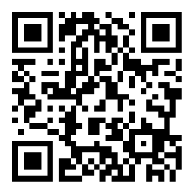
What is your
Daily screen time?
Notes:
Slido : Who do you think is responsible to prevent bad experiences for young people online?

Slide 3
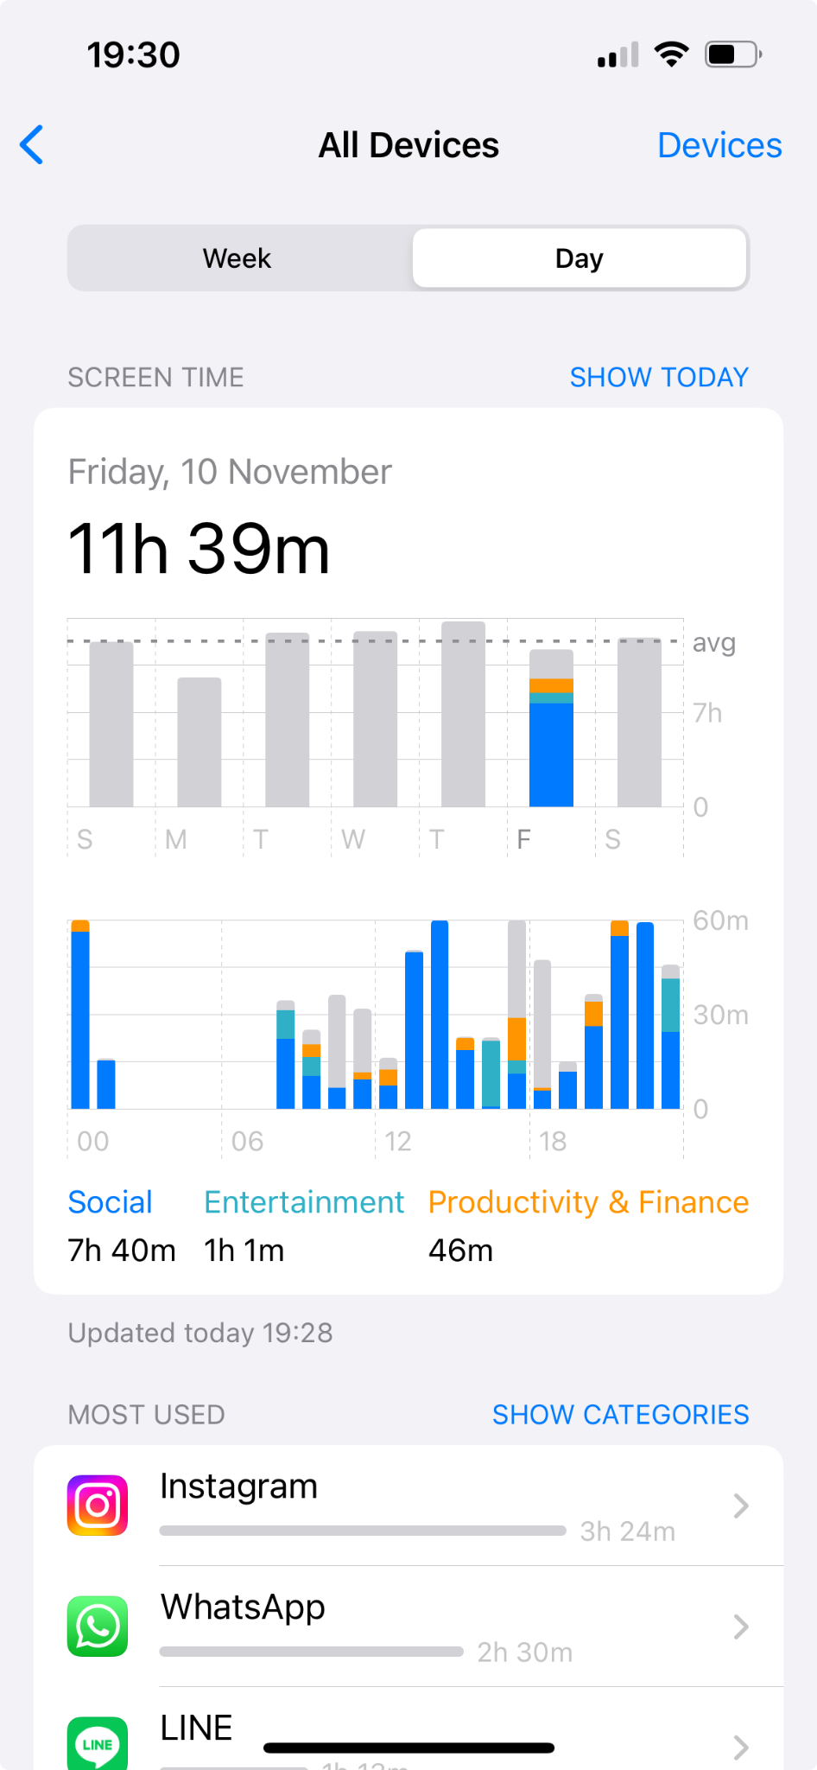
Notes:
Slido : What was your screen-time yesterday?

Slide 4
to get entertained
online education
IMPACTS
finding help
Widely available

Slide 5
to get entertained
mental health
grooming
hate speech
online education
CSAM
IMPACTS
finding help
online child sexual exploitation and abuse
physical health
Widely available
bullying

Slide 6
mental health
grooming
hate speech
CSAM
IMPACTS
online child sexual exploitation and abuse
physical health
bullying

Slide 7
(n = 10,891)
Reference : U-report valid survey responses from 9758 young people in Indonesia 476 young people in Thailand and 1032 young people in Cambodia

Slide 8
HOW COULD WE DEAL WITH THEM ?

Slide 9
Back to 2022,
7,321 Young people in ASEAN
were asked by UNICEF
What they want tech companies to do to keep their lives online safe, positive and fun places ?

Slide 10
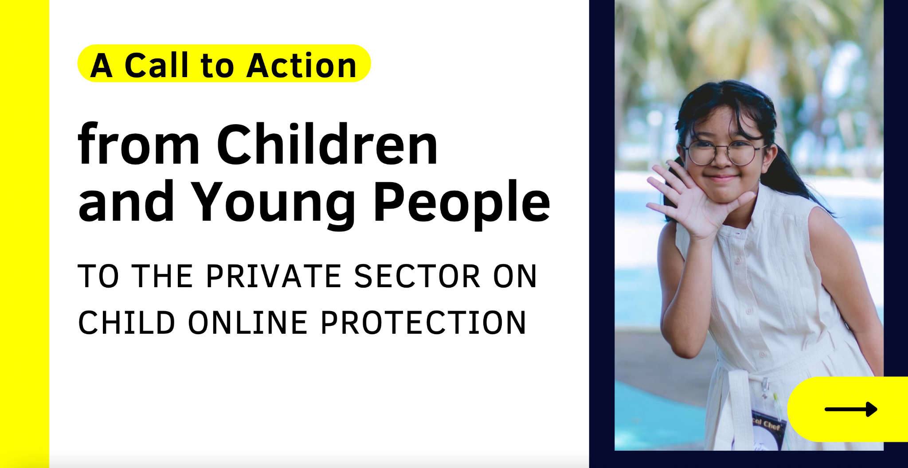
https://www.unicef.org/eap/documents/call-action-children-and-young-people
Notes:
A Call to Action from Children and Young People to the Private Sector on Child Online Protection.
This key document illustrates four key areas that children and young people want private sector to focus on in order to create a digital environment that centres the best interests of every child.

Slide 11
CHILD CENTERED FEATURES AND FUNCTIONS

Slide 12
Children and young people aged 12-24 years from Thailand often find the terms and conditions of platforms/services too long and difficult, so they usually just click ‘accept’.
Notes:
Fact : Children and young people aged 12-24 years from Thailand often find the terms and conditions of platforms/services too long and difficult, so they usually just click ‘accept’.
1. Companies should use clear, concise, and easy-to-understand language so that children and young people can make an informed decision before they enter a platform or use a product. / Consider their needs as a heart of design
2. Pop-up reminder should work for them to help them keep their personal information safe from strangers

Slide 13
EFFECTIVE REPORTING AND FEEDBACK MECHANISM

Slide 14
“ 29% of U-Reporters in Malaysia suggest that companies should establish easy reporting systems so that young people can quickly tell companies when they have a problem.”
Notes:
1.Respond promptly to user reports and take appropriate measures to protect victims of online safety breaches
2.Create and raise awareness about intuitive and child-friendly reporting mechanism that are easy to find and navigate.
Fact : 29% of U-Reporters in Malaysia sugges that companies should establish easy reporting systems so that young people can quickly tell companies when they have a problem

Slide 15
DIGITAL LITERACY AND ONLINE SAFETY GUIDANCE

Slide 16
“Tech companies should demonstrate and educate young people about cybersecurity.”
– Viet Nam, outcome of discussion among adolescent girls and boys
Notes:
1. Regularly share safety tips and produce interesting posts or videos about how to manage online safety in the digital world.
2. Provide service-specific guidance and information on online safety for both children and young people as well as parents, caregivers, and teachers.
3. Collaborate with government to develop curricula focused on online safety that can be taught in schools or via other activities in which children engage.

Slide 17
DATA PROTECTION AND RESPECT PRIVACY

Slide 18
“Data protection is important. Children can be really emotional. If their data is stolen when playing games, it can impact their emotion.”
– Indonesia, boy in the age group of 12-14 years
Notes:
Fact: Data protection is important. Children can be really emotional. If their data is stolen when playing games, it can impact their emotion
1. Empower children to easily access and adjust their privacy settings.
2. Strengthen data security to prevent hacking or invasion of users’ privacy.

Slide 19
Back to present,
11,266 young people in Cambodia, Thailand and Indonesia were asked if
They have seen anything change in the last year?
Notes:
It is interesting to see the progress if they have seen anything change in the last year

Slide 20
What is your level of comfort about how to secure your personal data is compared to a year ago ?
(n = 8,130)

Slide 21
Who
do you think is responsible to prevent bad experiences for young people online?
Notes:
Slido : Who do you think is responsible to prevent bad experiences for young people online?

Slide 22
Who do you think is responsible to prevent bad experiences for young people online ?
(n = 9,630)

Slide 23
EVERYONE
Notes:
I personally think that it’s responsible to all of us to cooperate and go forward together.
And today, I’m here to promise that We,as young people,are ready to be part of making online communities safer places for everyone :)

Slide 24
Every child should be safe to
connect, learn and grow online.
Notes:
Every child should be safe to connect learn and grow online. Thank you

